Slide 1
Amazon Web Service

Slide 2
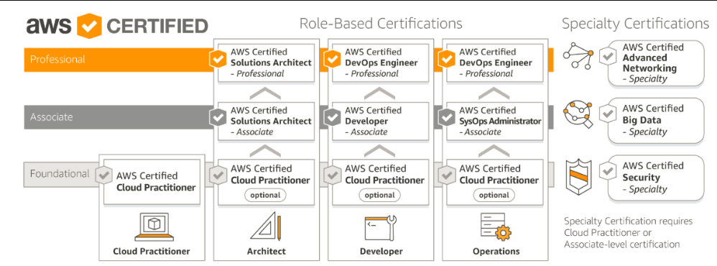
Exam

Slide 3
AWS has 3 Certification Tracks for Associate Level:
AWS Certified Solutions Architect – Associate Level
AWS Certified Developer – Associate Level
AWS Certified SysOps Administrator – Associate Level
AWS has 2 Certification Tracks for Professional Level:
AWS Certified Solutions Architect – Professional Level (Architect Associate Certification is a prerequisite)
AWS Certified DevOps Engineer – Professional Level (Developer or SysOps Associate Certification is a prerequisite)
AWS offer following Specialty Certifications which can be taken up after clearing any of the Associate Certifications.
Advanced Networking
Big Data
Security

Slide 4
Contents
EC2
Launch Instance
AMI
Elastic Block storage
Networking and security
Load balancer
Autoscaling
Storage
S3(Simple storage service)
EFS (Elastic File System)
Glacier

Slide 5
Contents
Networking and content Delivery
Subnet
Route table
Internet Gateways
Elastic ip
NAT Gateway
Peering Connection
Route53

Slide 6
Contents
IAM
Database
RDS
Dynamodb
Amazon Redshift
Management tool
Clouwatch
Application Integration
SQS
SNS

Slide 7
Basic Type of Cloud Service
The three basic types of cloud services are:
Computing
Storage
Networking
Here are some of the AWS products that are built based on the three cloud service types:
Computing - These include EC2, Elastic Beanstalk, Lambda, Auto-Scaling, and Lightsat.
Storage - These include S3, Glacier, Elastic Block Storage, Elastic File System.
Networking - These include VPC, Amazon CloudFront, Route53

Slide 8
Job Opportunity
Cloud Engineer
Cloud Solution Architect
Cloud Systems Administrator
Cloud DevOps Engineer
Cloud Developer
Cloud Security Engineer
Cloud Network Engineer
Cloud Data Architect
Cloud Consultant

